Slide 1
Academies of Loudoun
Makerspace
Josh.Ajima@lcps.org

Slide 2
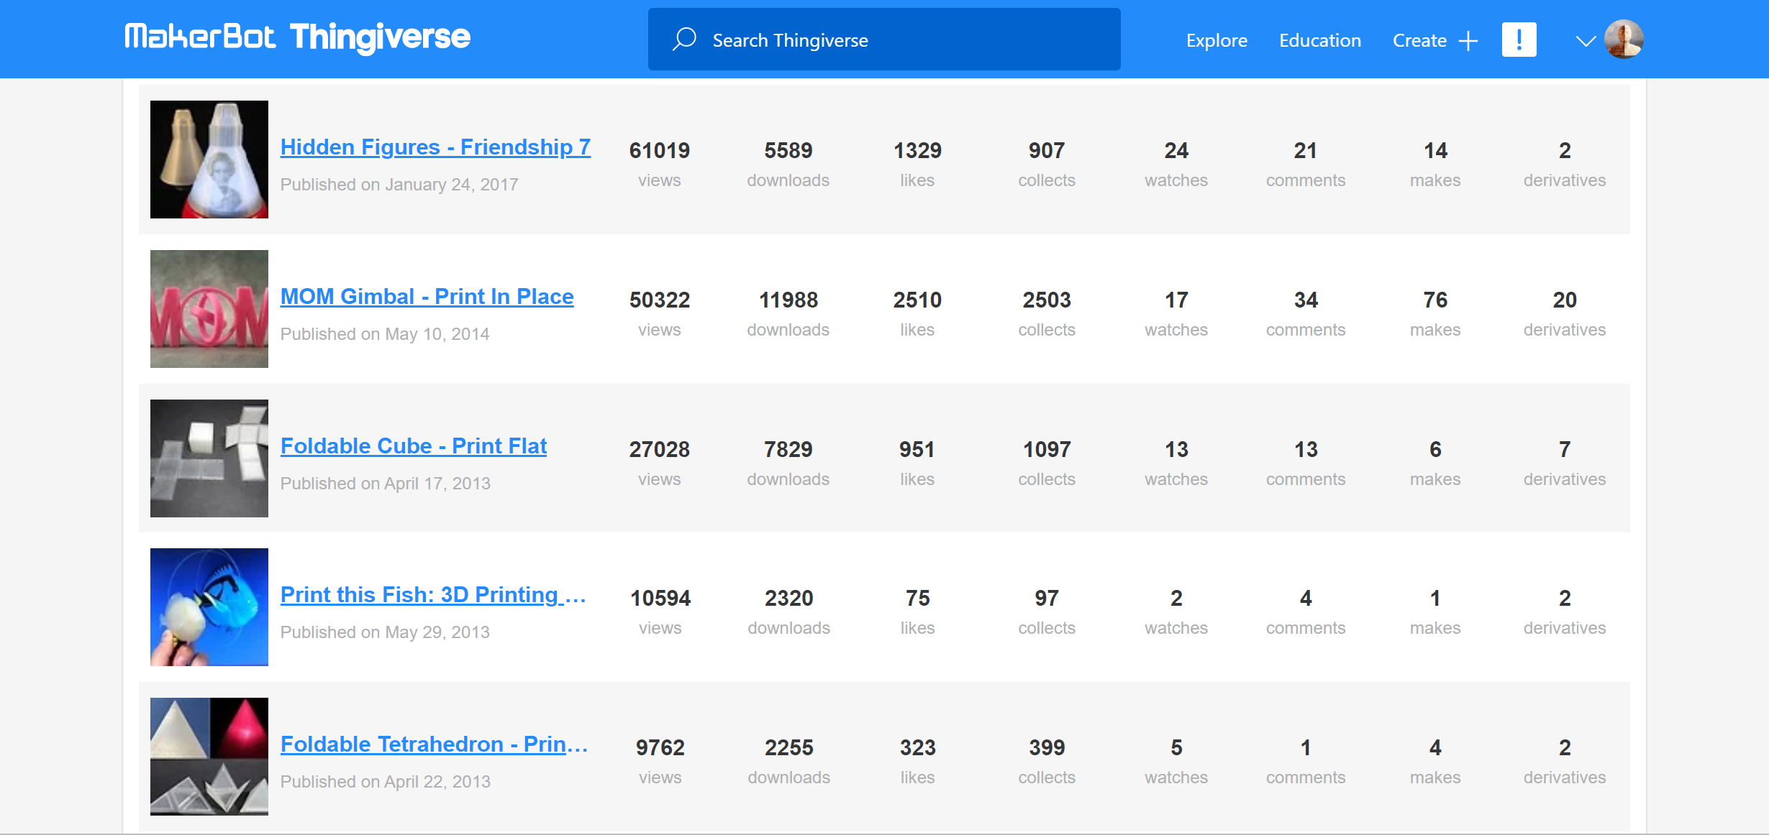
Maker
Notes:
Personal 3D printing portfolio.

Slide 3
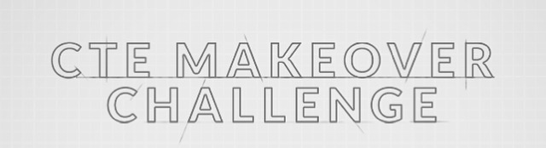
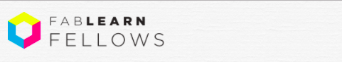
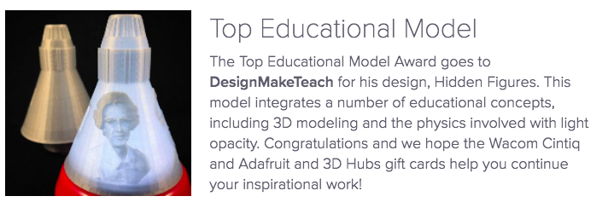
Maker Educator
VSTE Innovative Educator of the Year
US Department of Education’s CTE Makeover Challenge Winner
Columbia FabLearn Fellow
Formlabs 3D Design Awards - Top Educational Model
Makerspace Facilitator
-Academies of Loudoun
Notes:
New role of makerspace facilitator: job did not exist 10 years ago.

Slide 4
“We are all Makers.”
-Dale Dougherty
Notes:
Dale Dougherty, co-founder of Maker Faire and Make Magazine has a wonderful TED talk we are all makers. This is a great video to show your faculty, students and parents when growing support for making in your school. http://www.ted.com/talks/dale_dougherty_we_are_makers?language=en

Slide 5
Makerspace
is an idea

Slide 6
Learn
by
Making

Slide 7
Time
Space
Materials
Resources

Slide 8
The mission of the Academies of Loudoun is to empower students to
explore, research, collaborate, innovate,
and to
MAKE
meaningful contributions to the world in the fields of science, technology, engineering and mathematics.

Slide 9
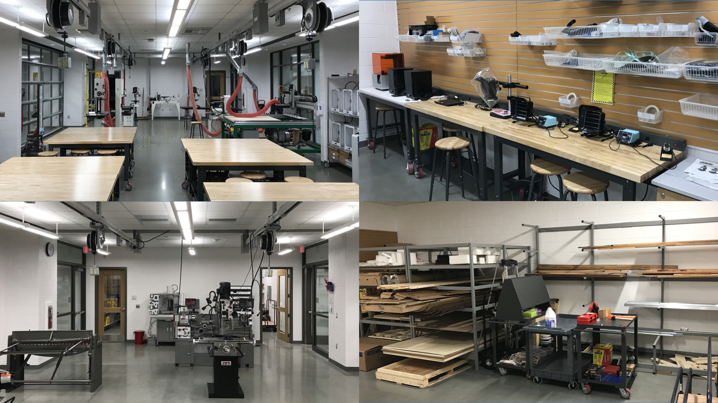
Notes:
Starting point for access to materials and tools outside your classroom
-Make Almost Anything : human scaled projects
-Chemical, biological and nano materials in other labs
-Makerspace Facilitator to support

Slide 10
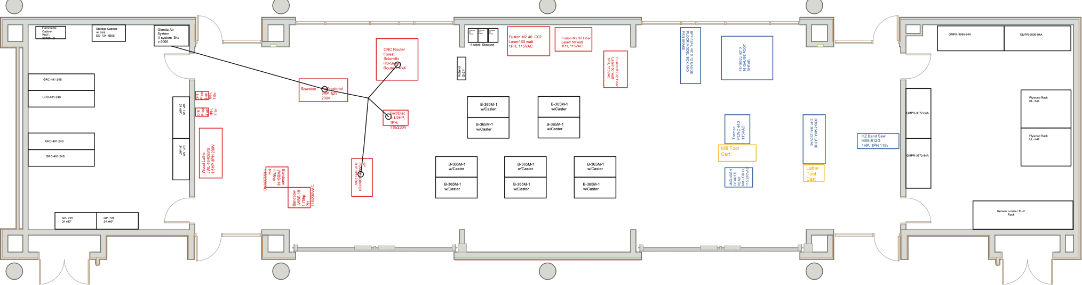
Innovation Commons
AET Engineering Labs
Notes:
The makerspace is 2,300 sq ft with 900 sq ft of tool and material storage in the heart of the Innovation Commons.

Slide 11
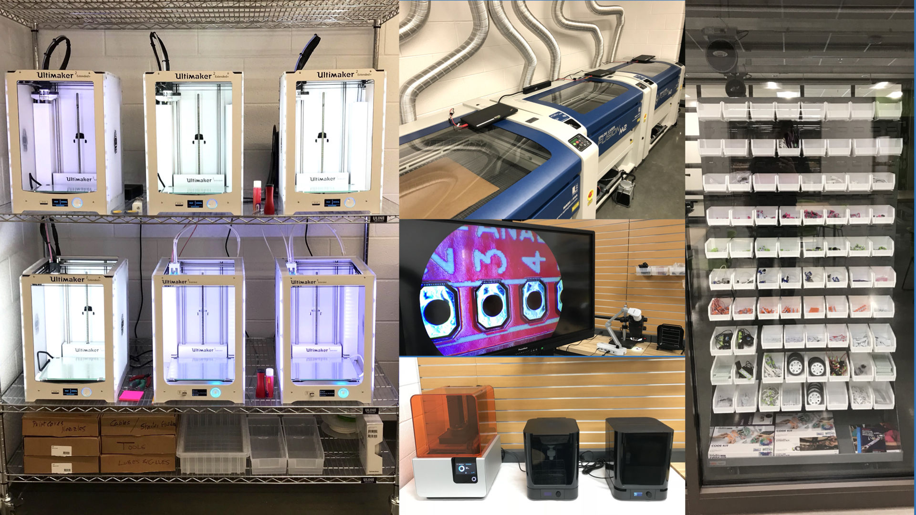
Notes:
The space includes woodworking, metal working and digital fabrication tools including 7 – 3D printers, 3 - laser cutters, 3 - CNC machines and 2 - vinyl cutters, in addition to an array of electronics, physical computing devices and the cameras to document projects and the learning that takes place.

Slide 12
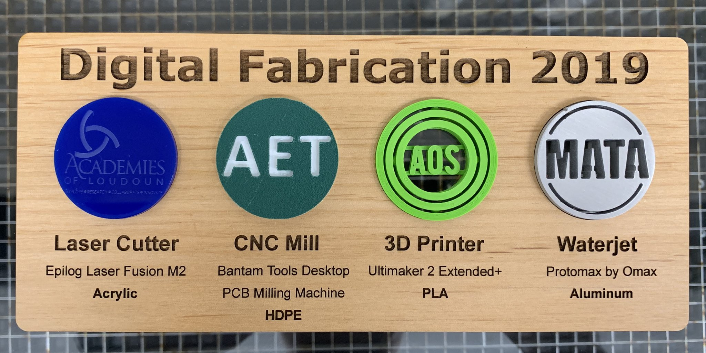
Notes:
All of the tools give us a wide-range of capabilities, some of which are shown in this time capsule artifact showcasing the state of digital fabrication in 2019.

Slide 13
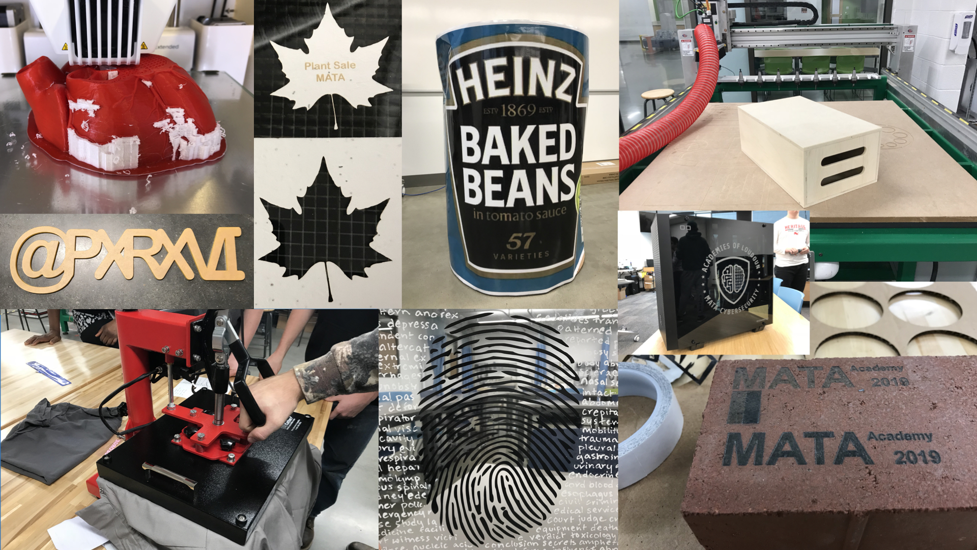
Notes:
Project examples.

Slide 14
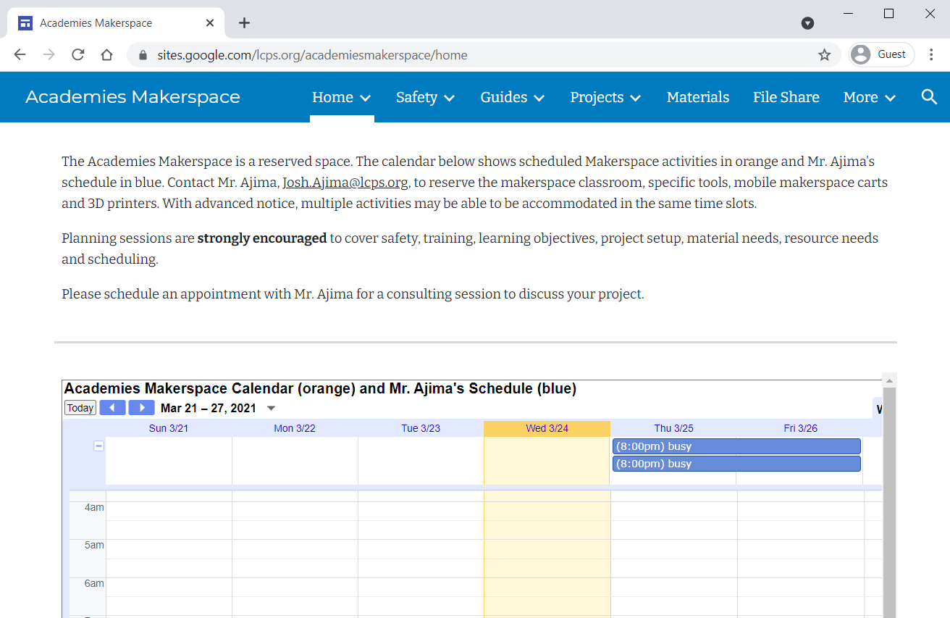
lcps.org/aclmakerspace
Notes:
Public facing website.

Slide 15
Green Orientation (GO) Check-Off
Signed Makerspace Safety Acknowledgement (Permission Click)
2. 100% on General Lab Safety Test (Schoology)
3. Green Orientation Training & Assessment (In Person)
Notes:
Requirement to work independently in the makerspace.

Slide 16
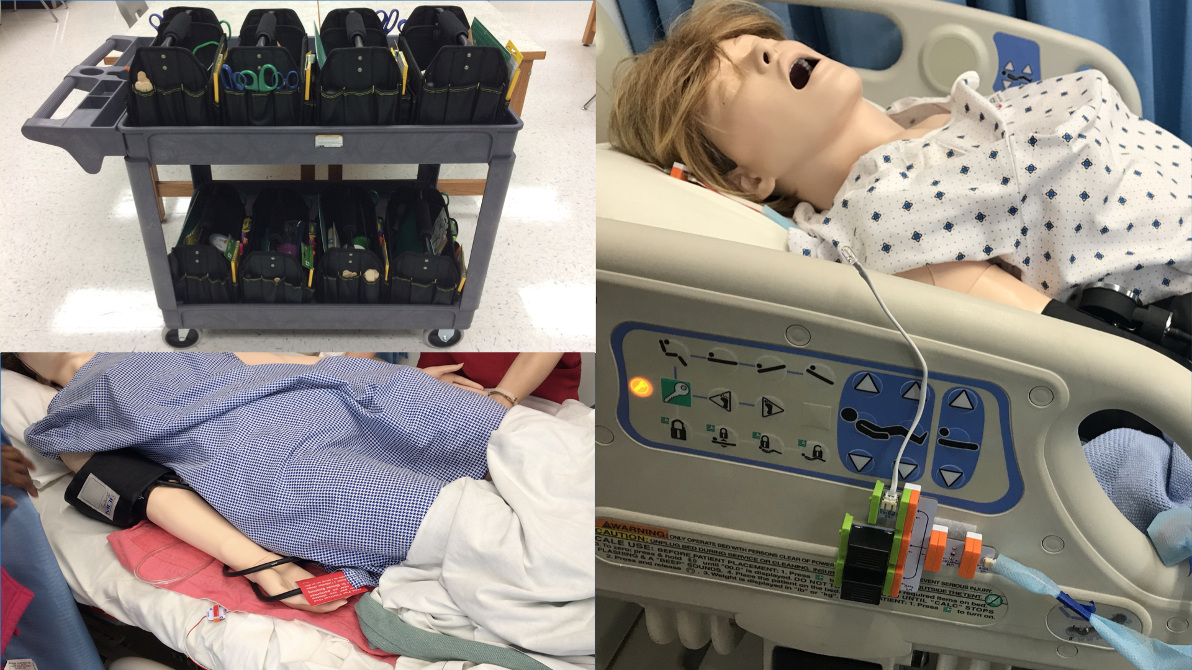
Notes:
Medical device prototyping.

Slide 17
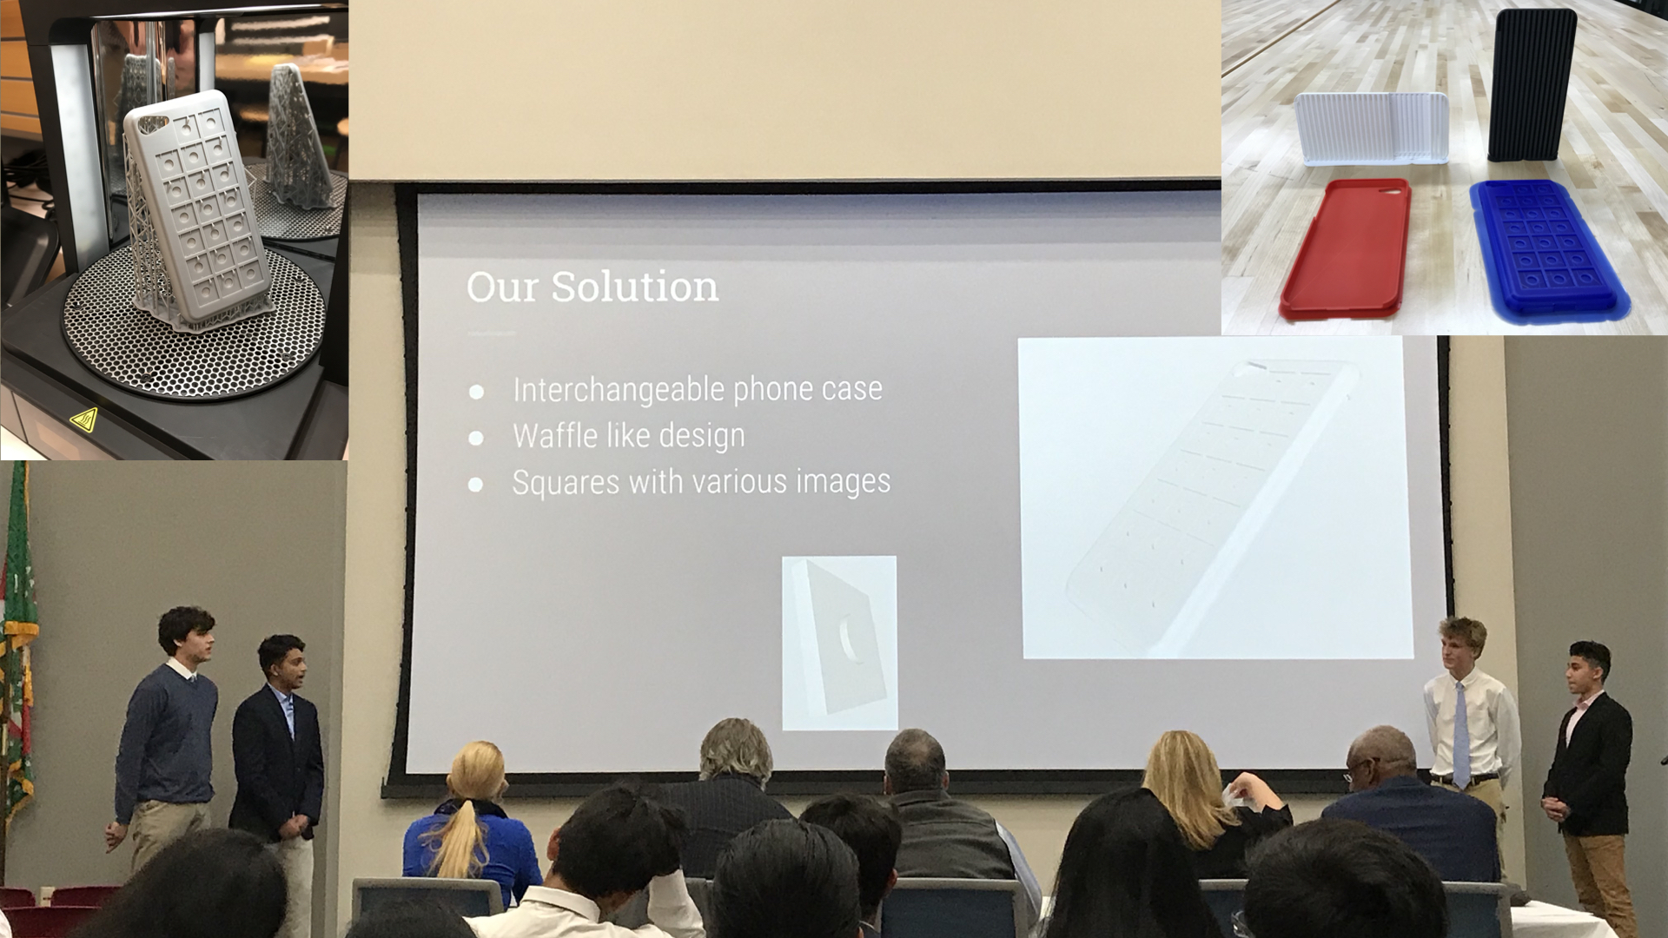
Notes:
AET Entrepreneurship example.

Slide 18
Every interaction is a collaboration

Slide 19
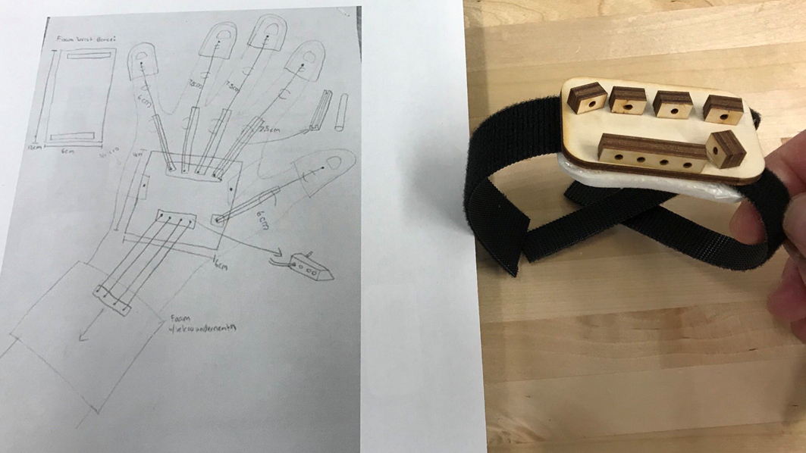
Sketch and links
Notes:
Sketch
-Measurements
-Photos
-Amazon links (catalog)
-Instructables
-Thingiverse/GrabCAD
-Research link

Slide 20
Low Fidelity Prototyping
Notes:
Low Fidelity Prototype: Cardboard, littleBits, micro:bits, crafting, Strawbees, PVC, makerpipe

Slide 21
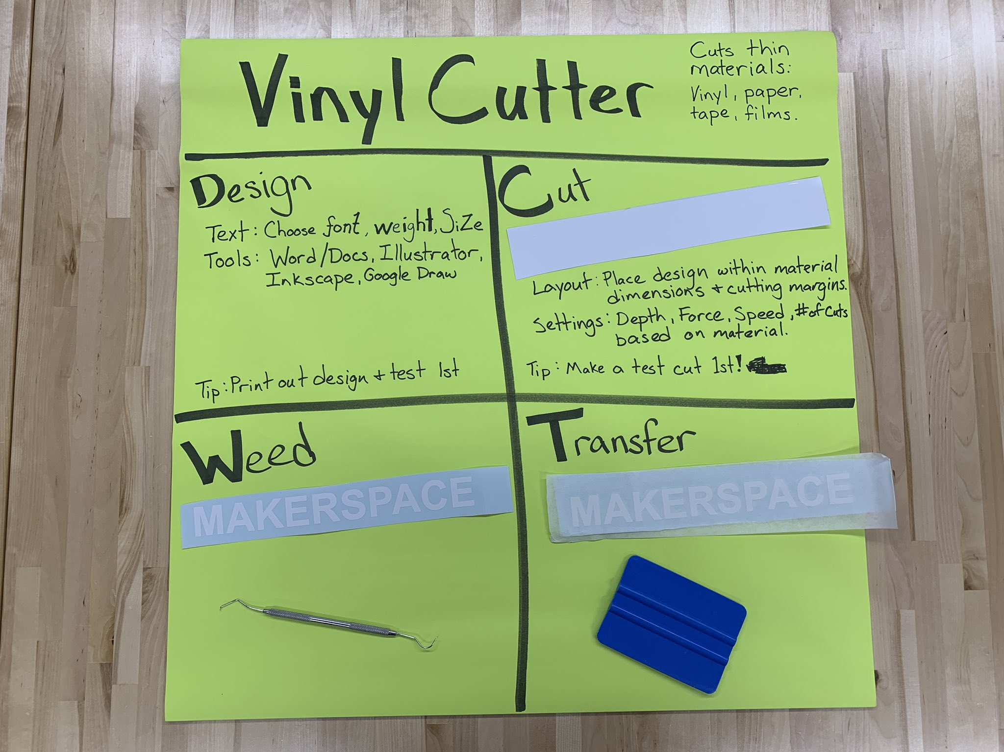
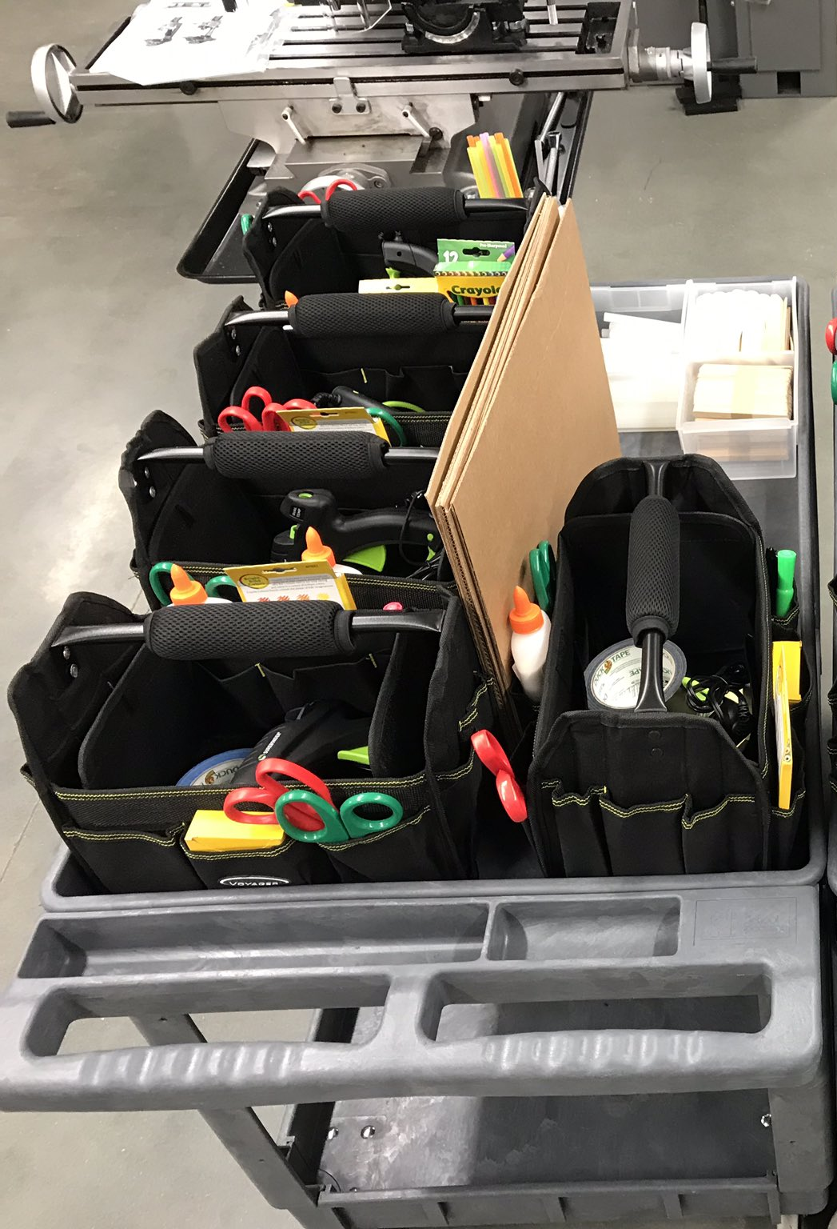
Notes:
Vinyl Cutter and maker cart. Tool tote with crafting supplies.

Slide 22
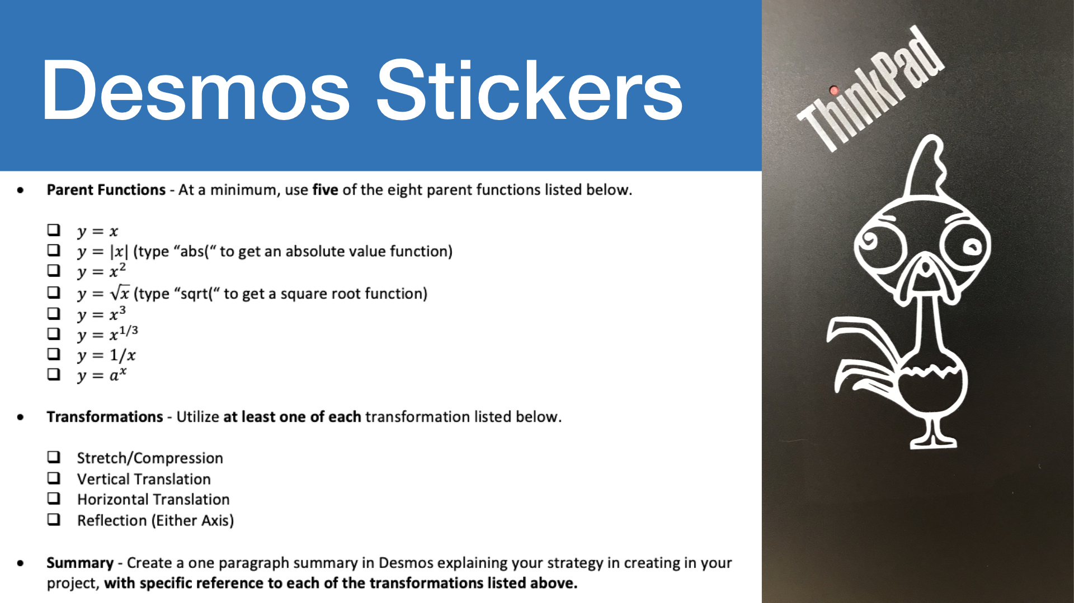
Notes:
AET Math example. Teacher asked if I could 3D print a handful of the designs. I suggested vinyl cutter.

Slide 23
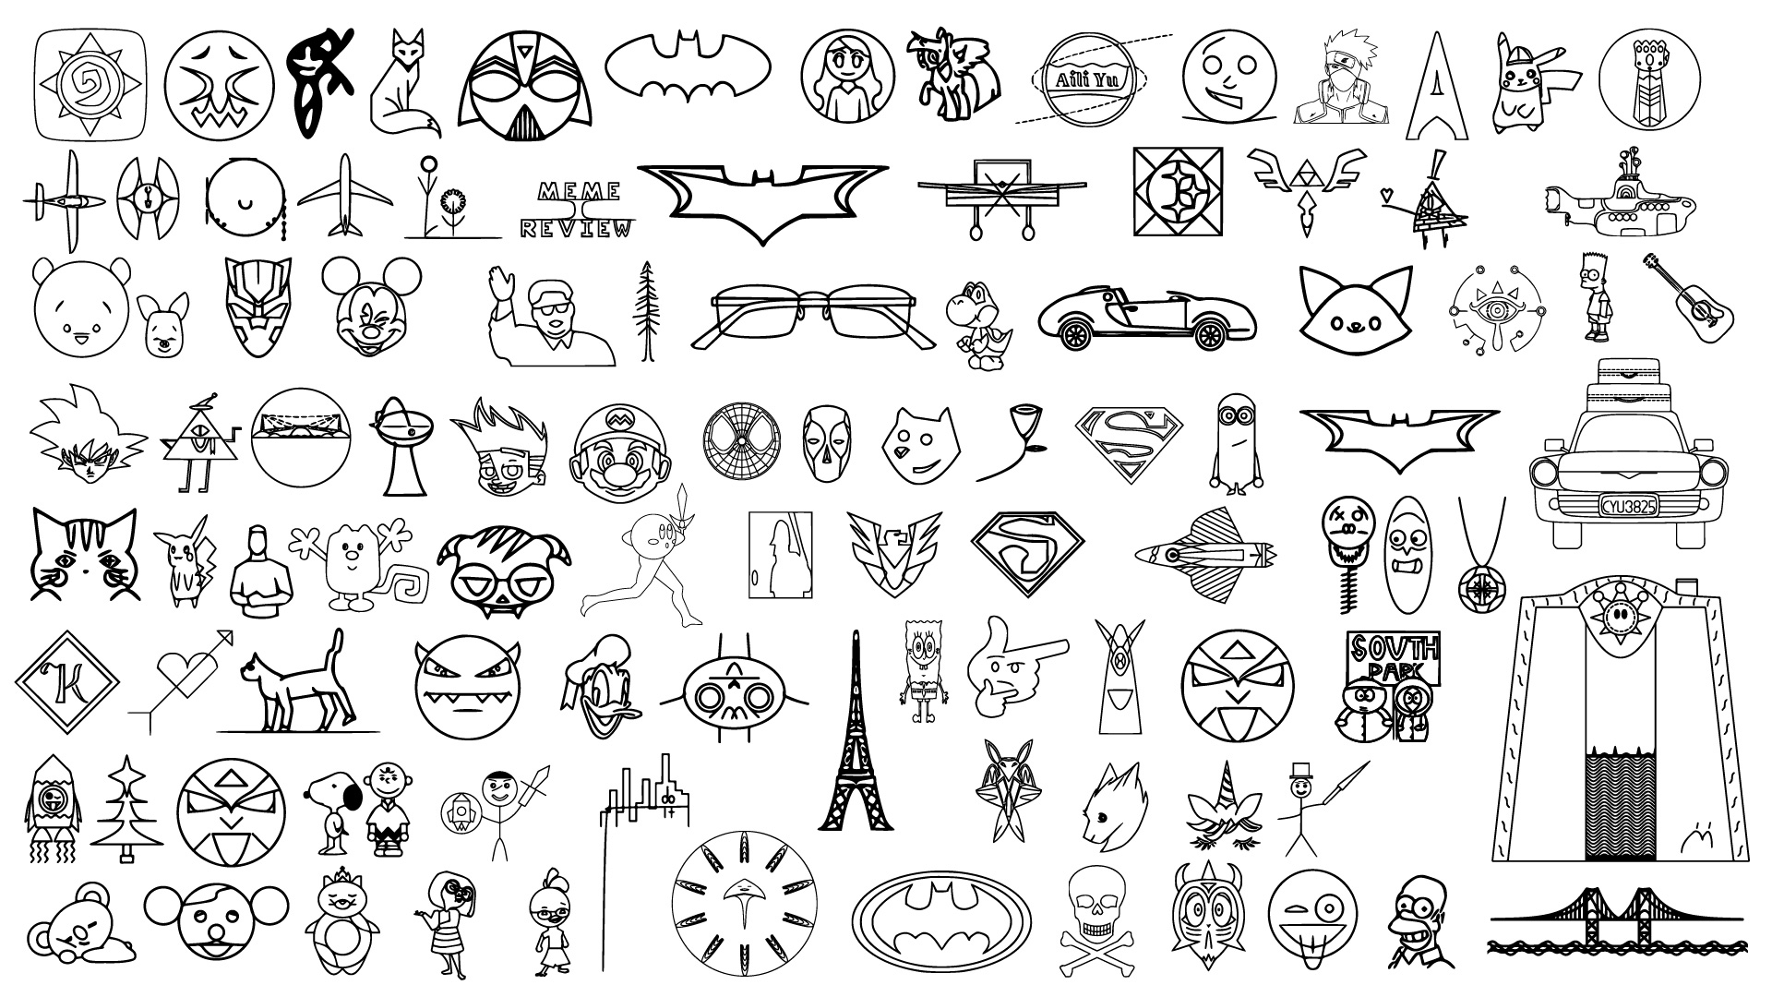
Notes:
Making at scale. Everyone making something.

Slide 24
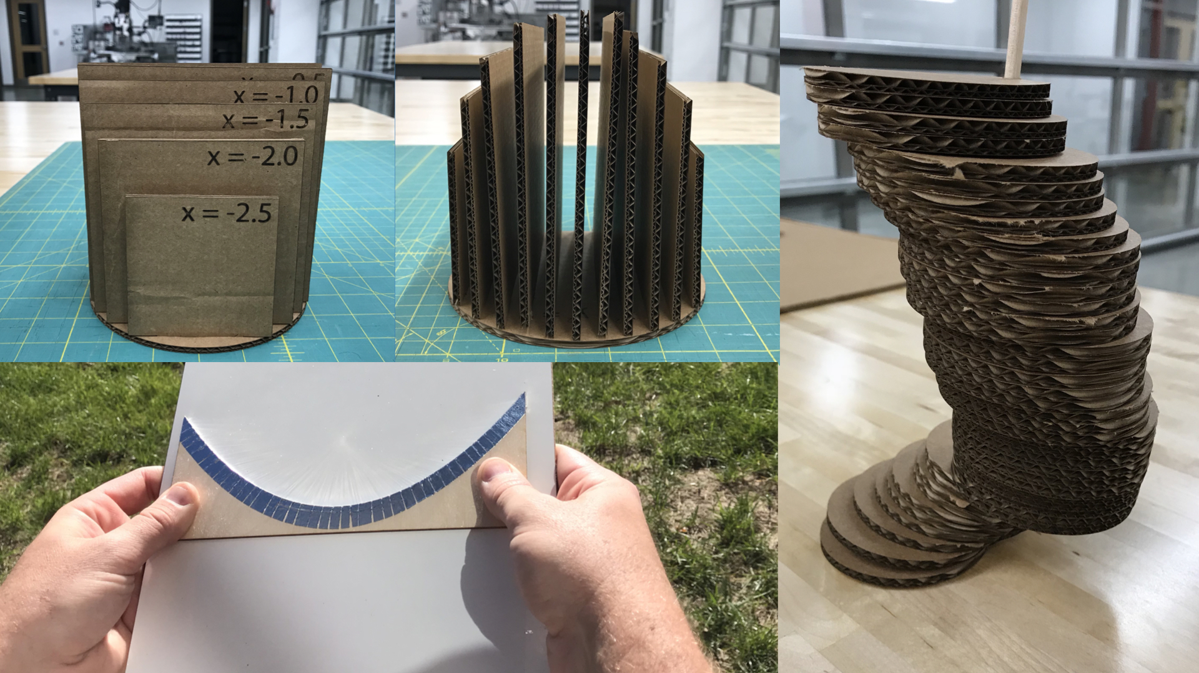
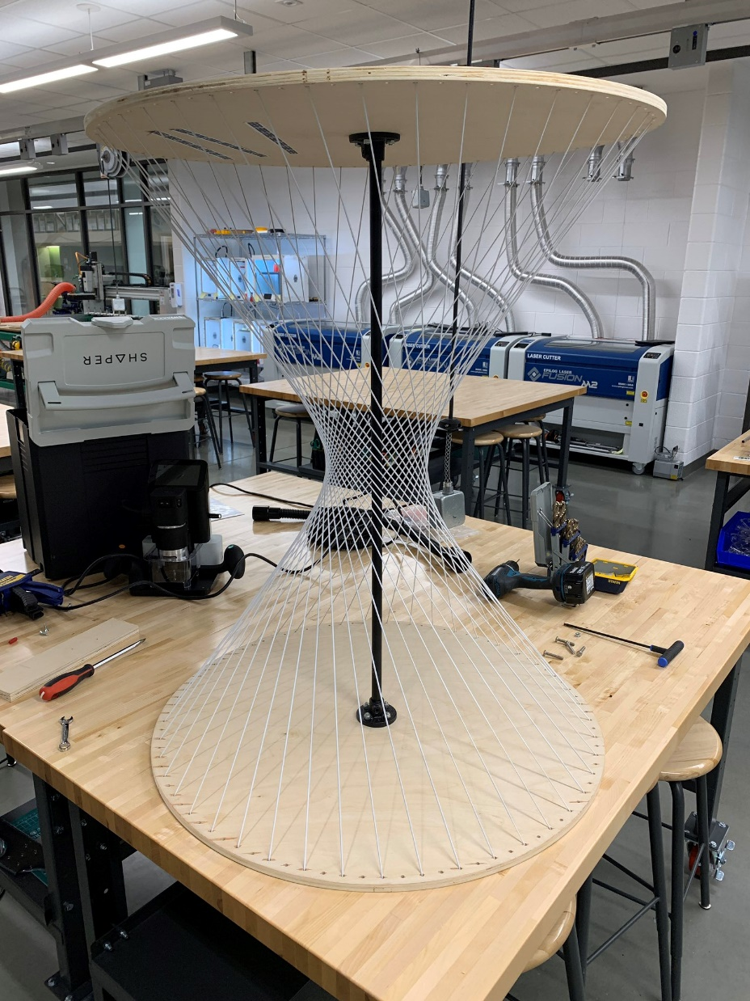
Notes:
Math exploration with digital fabrication.

Slide 25
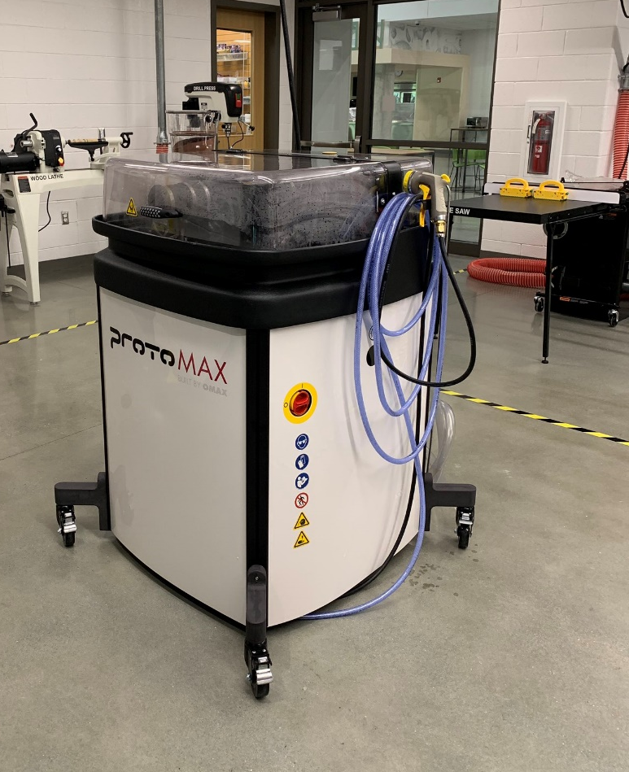
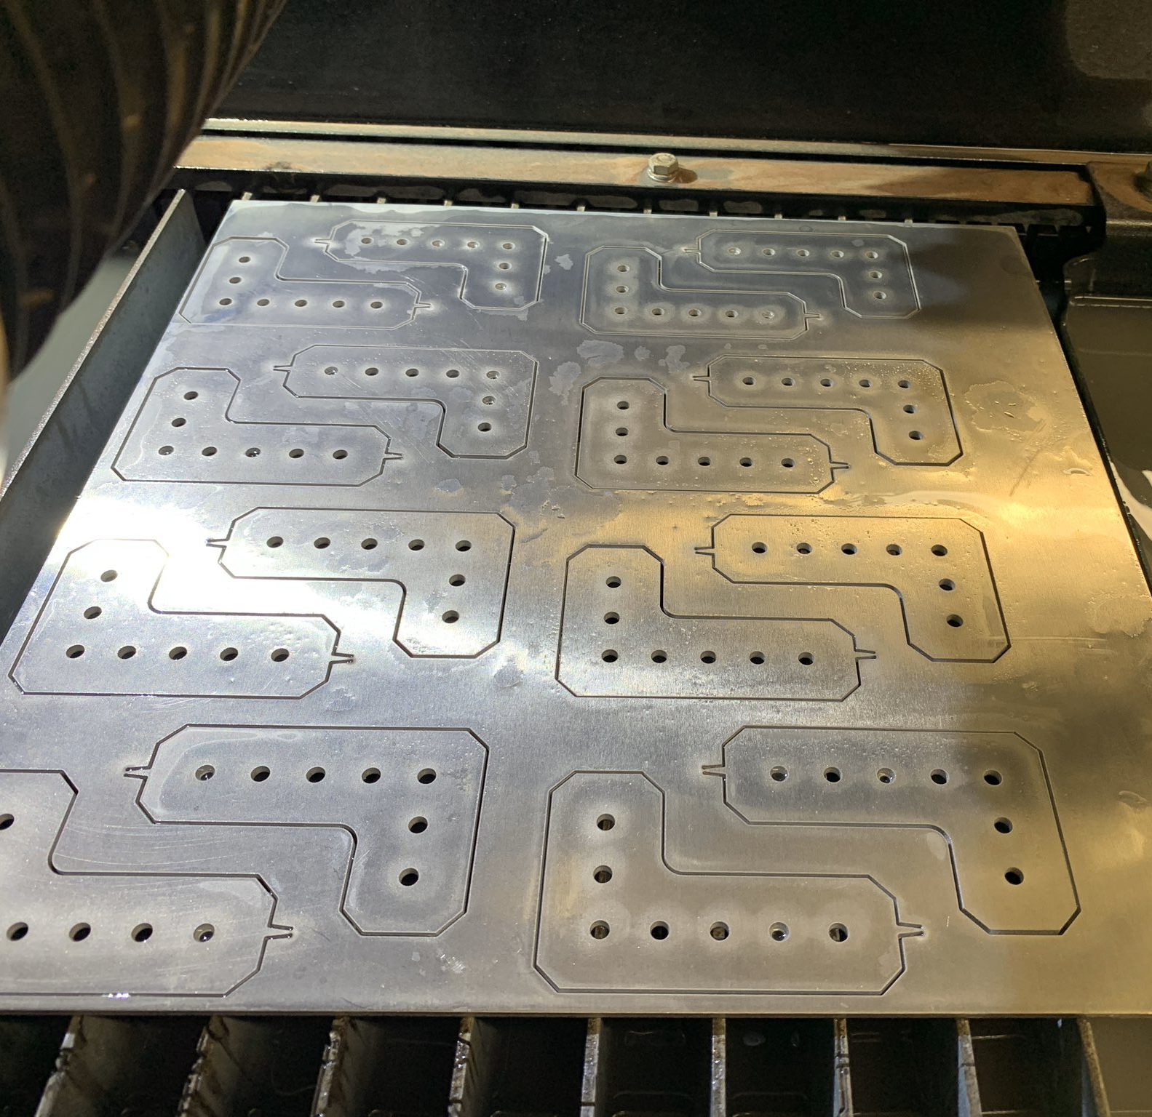
Notes:
Here is a small-scale waterjet that we bought our second year. Cuts almost anything.

Slide 26
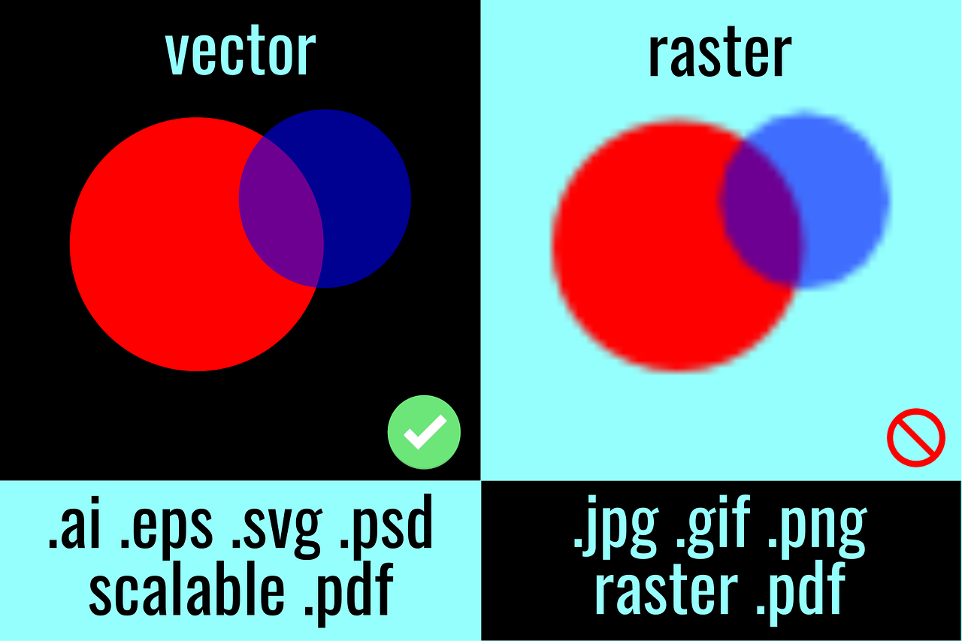
2D Design: Vector vs Raster

Slide 27
2D Vector Design: Getting Started
Google Slides
Adobe Illustrator
Tinkercad

Slide 28
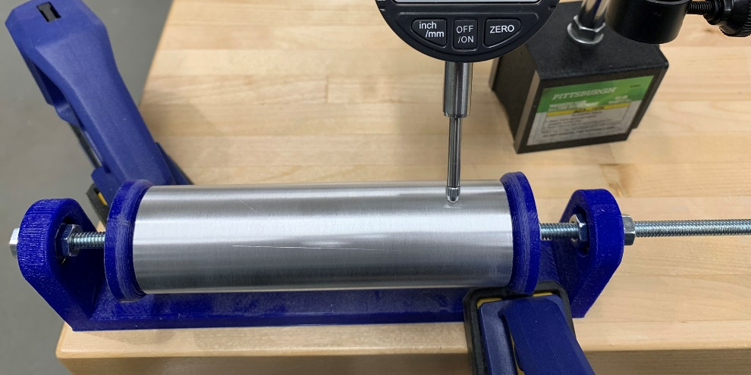
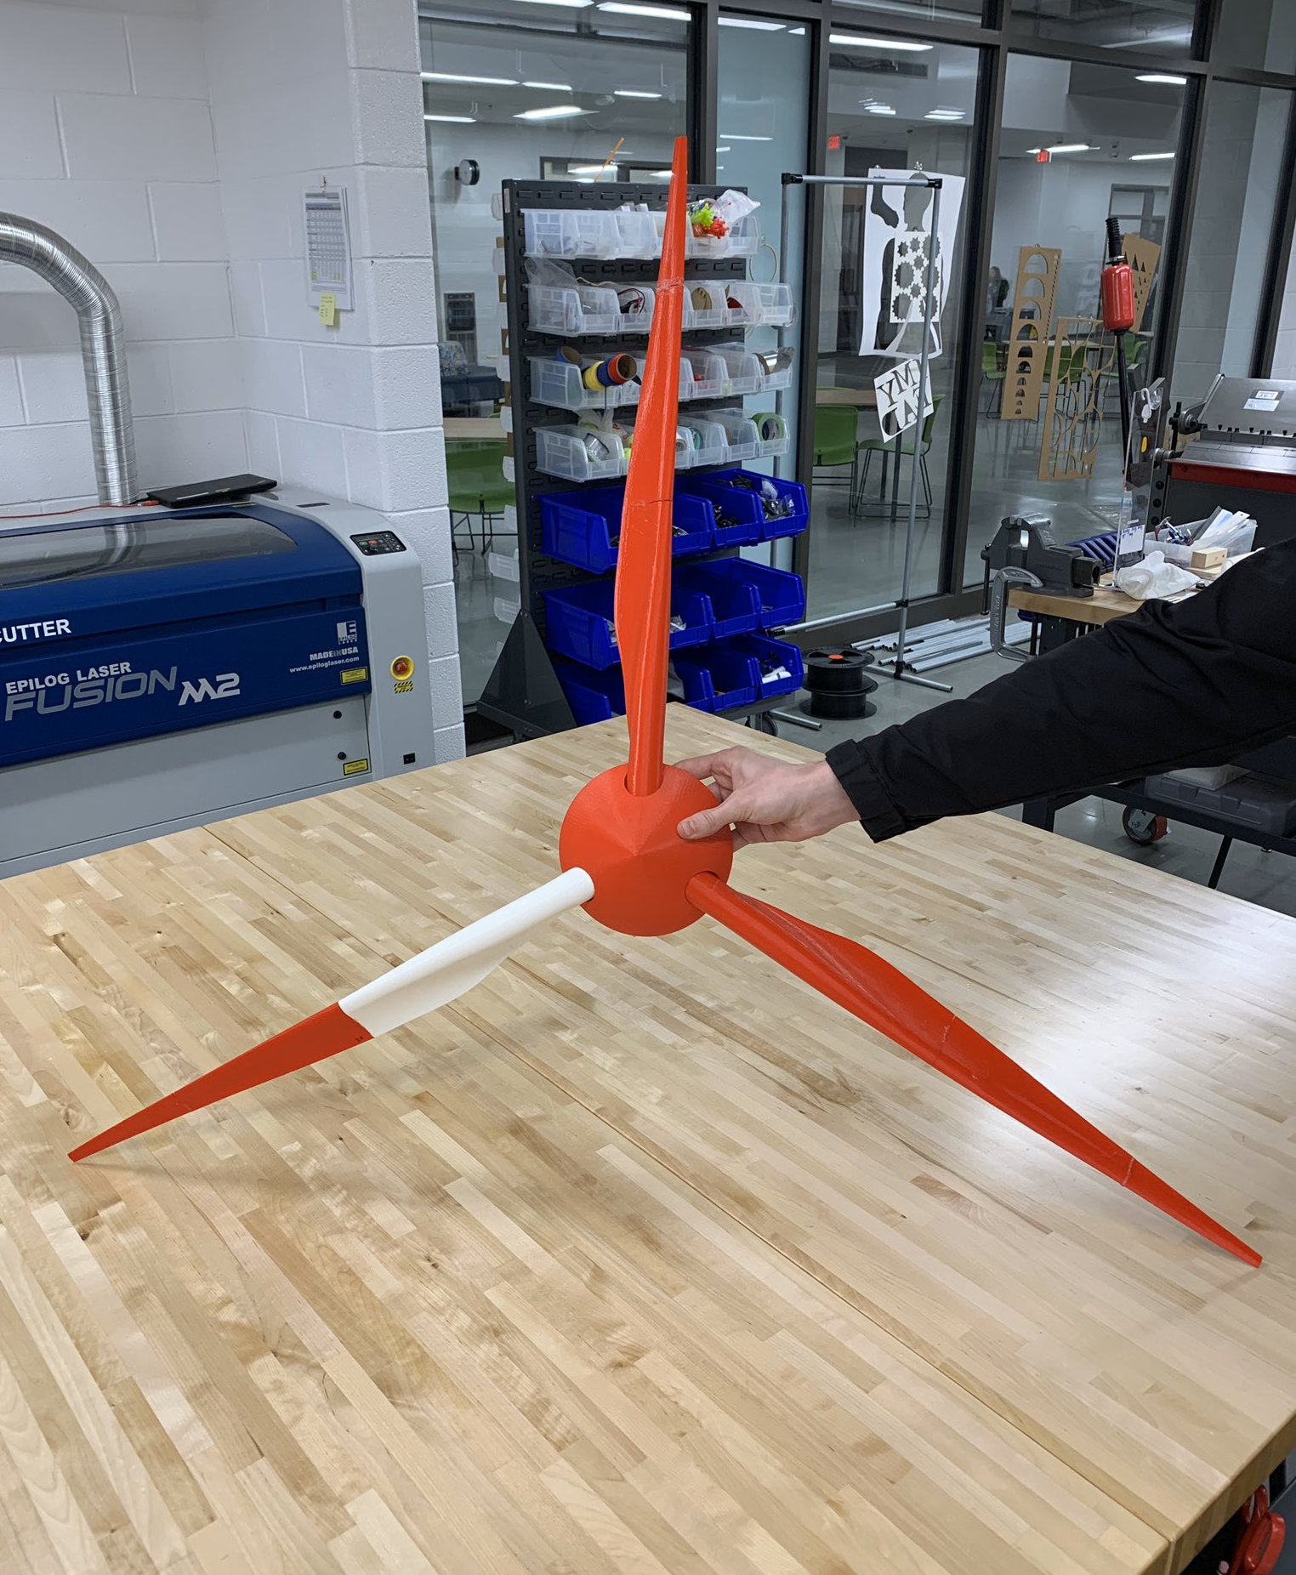
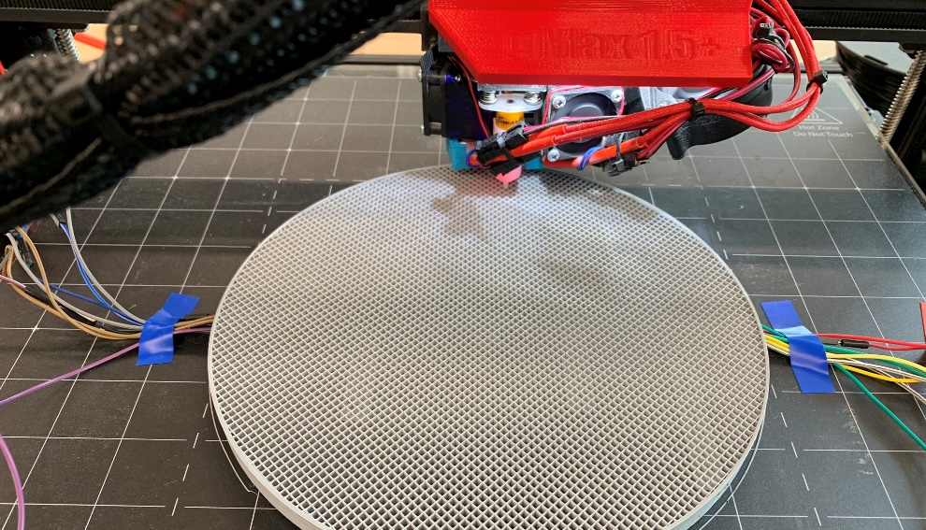
Notes:
Engineering

Slide 29
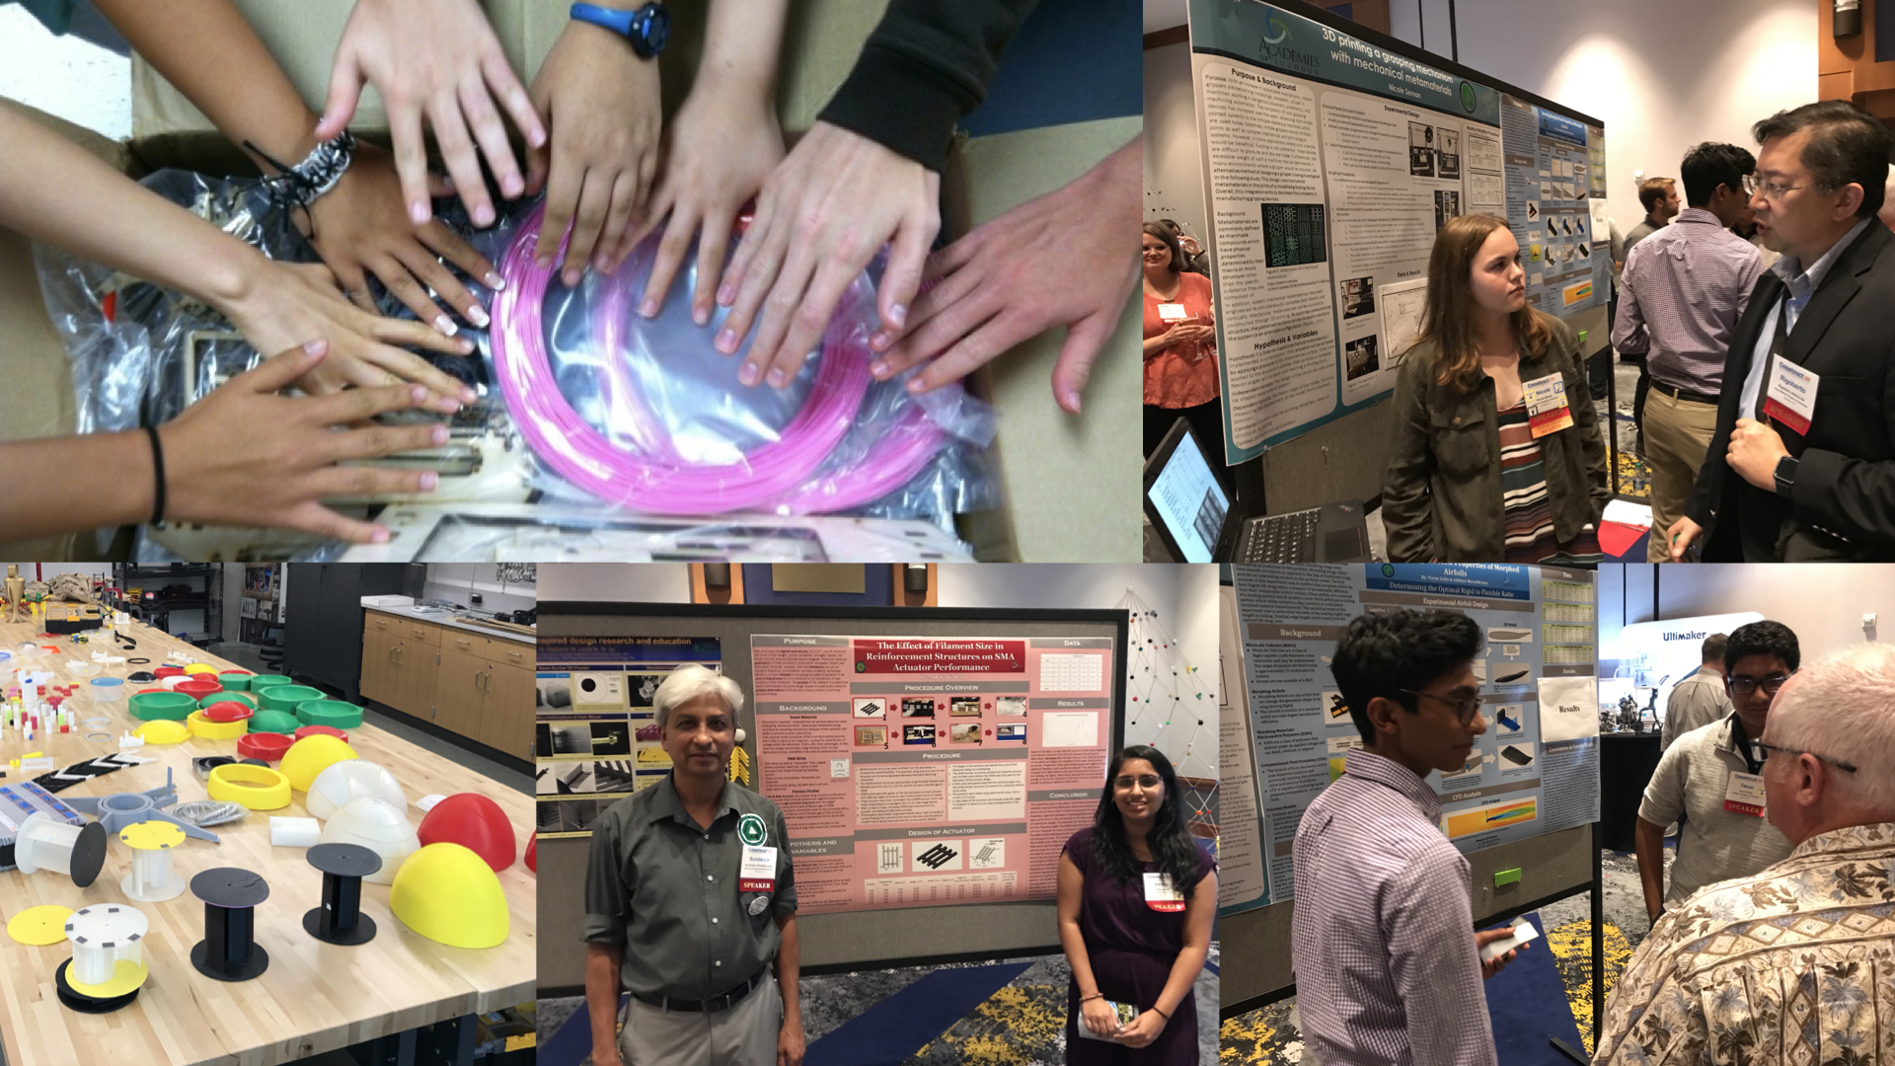
Notes:
AOS research engineering students presenting at Construct3D conference at Georgia Tech in 2019.

Slide 30
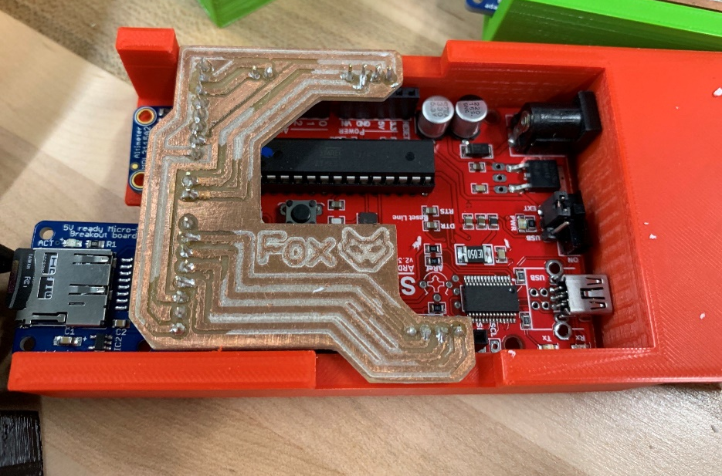
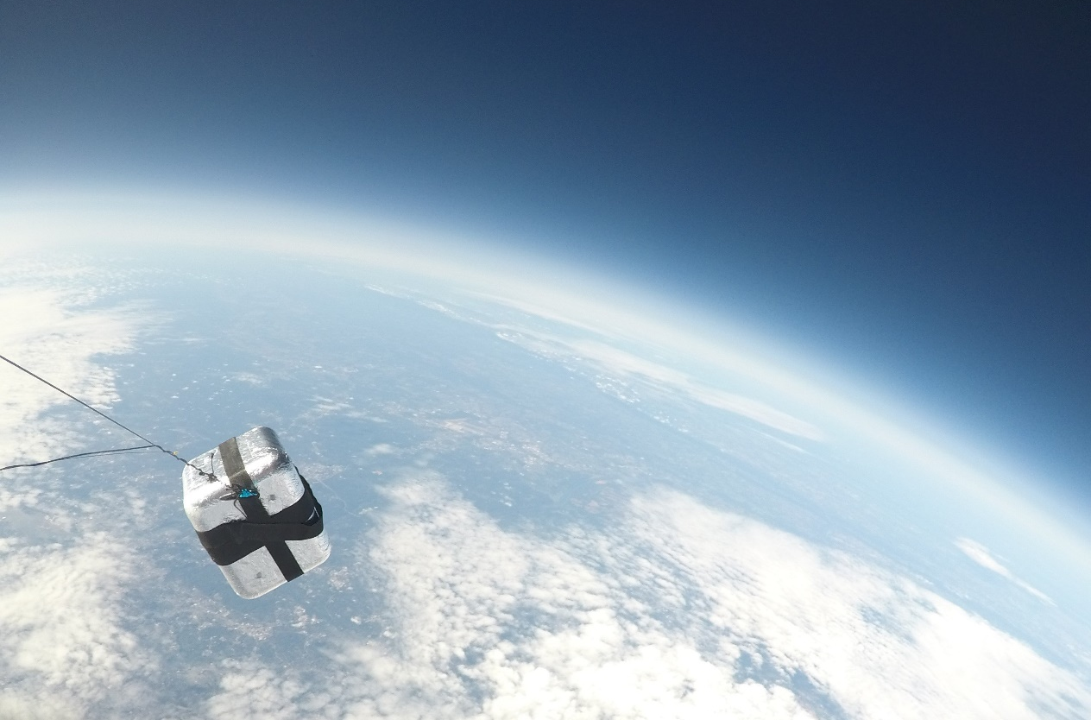
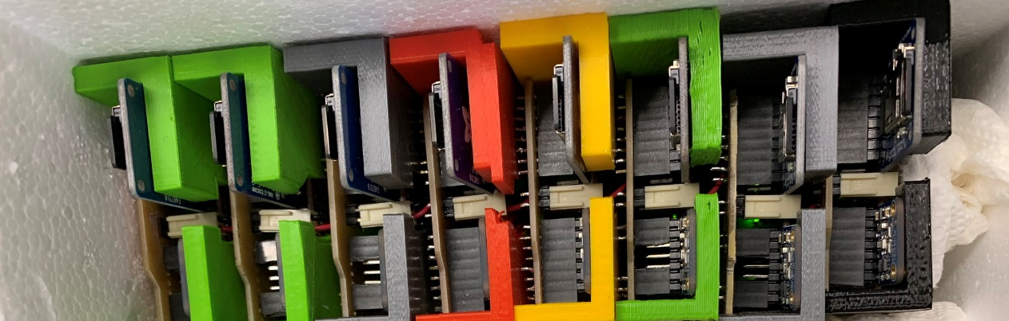
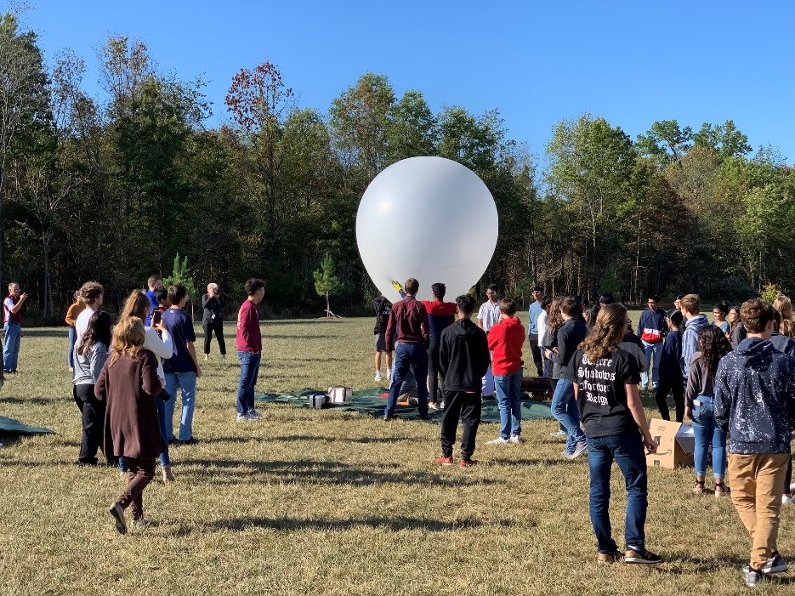
Notes:
High Altitude Balloons: student designed and fabricated a custom sensor shield and housing and hundreds of students were part of the launch, data collection

Slide 31
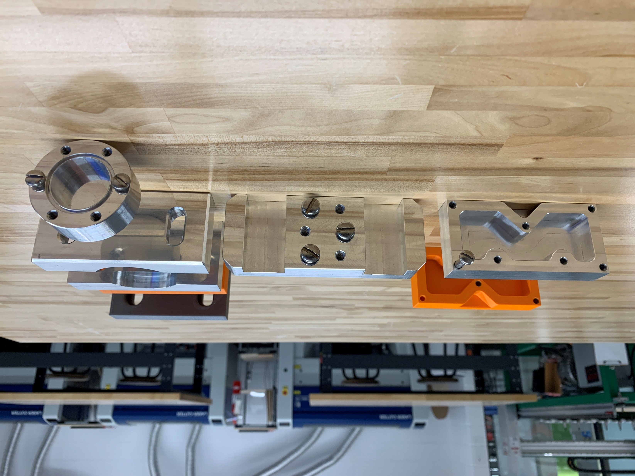

Slide 32
3D Design: Getting Started
Tinkercad
Fusion 360
OnShape

Slide 33
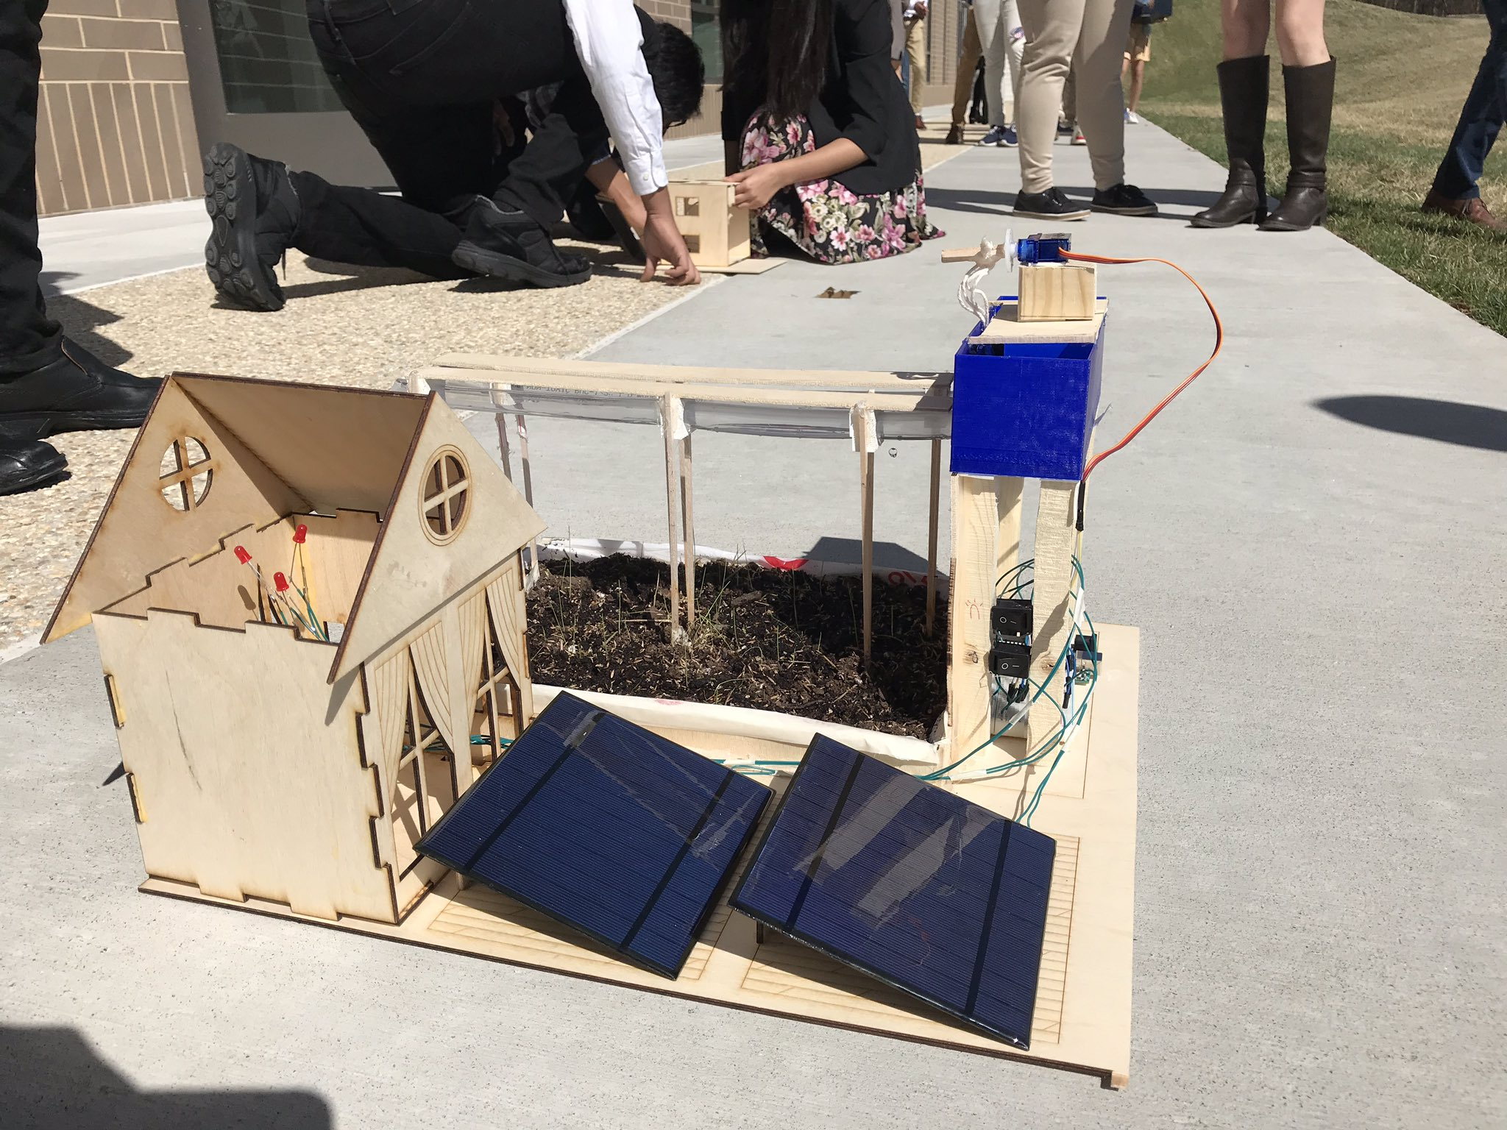
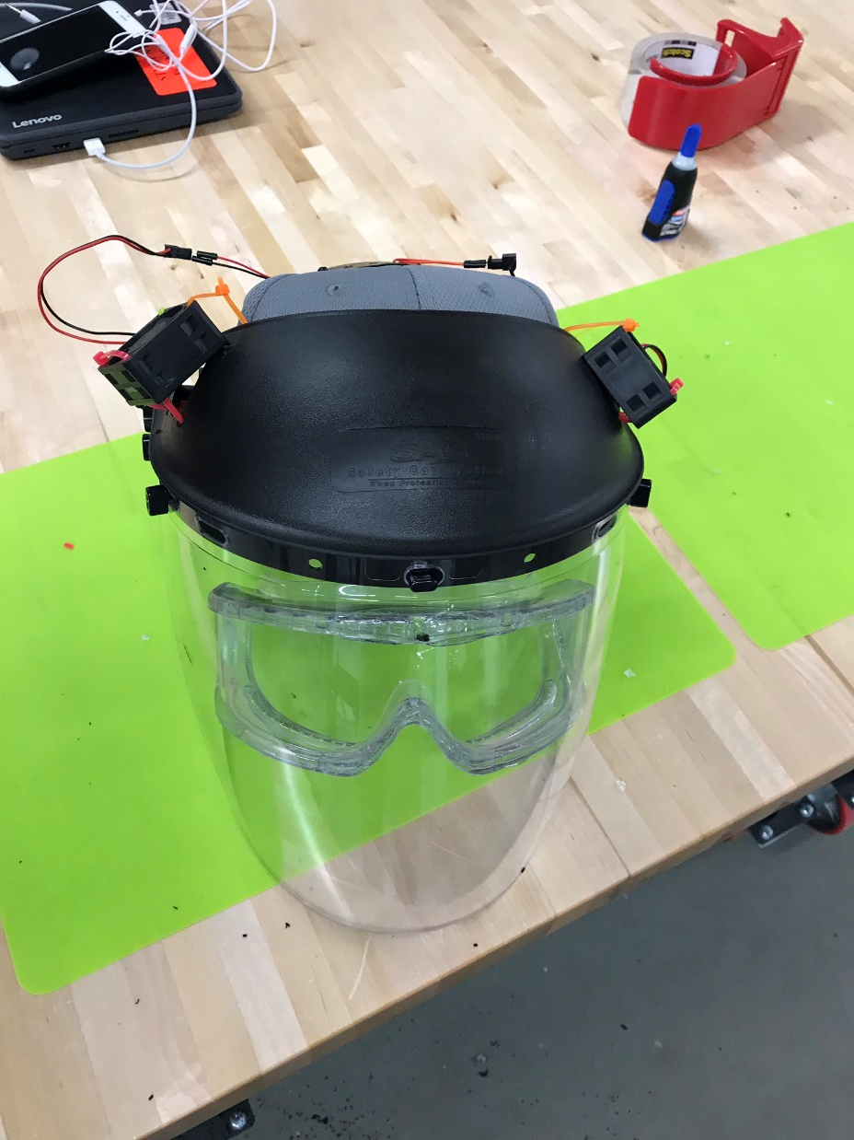
Notes:
These projects starting becoming more complex. On the left is a solar powered farm model powered by arduino. On the right is PPE for chicken farmers.

Slide 34
Electronics: Getting Started
Tinkercad
MakeCode
Scratch

Slide 35
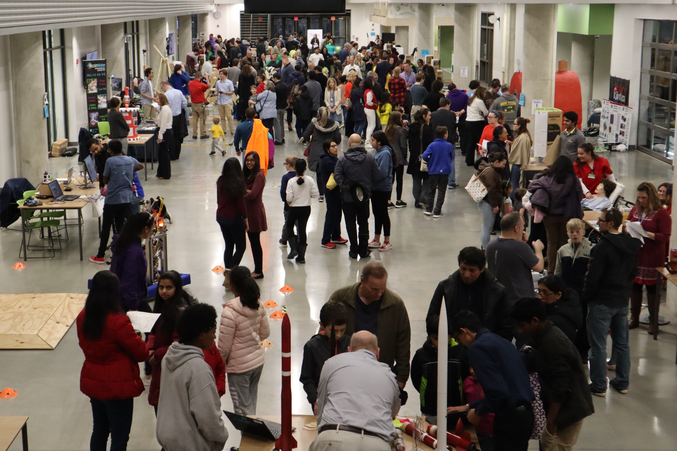
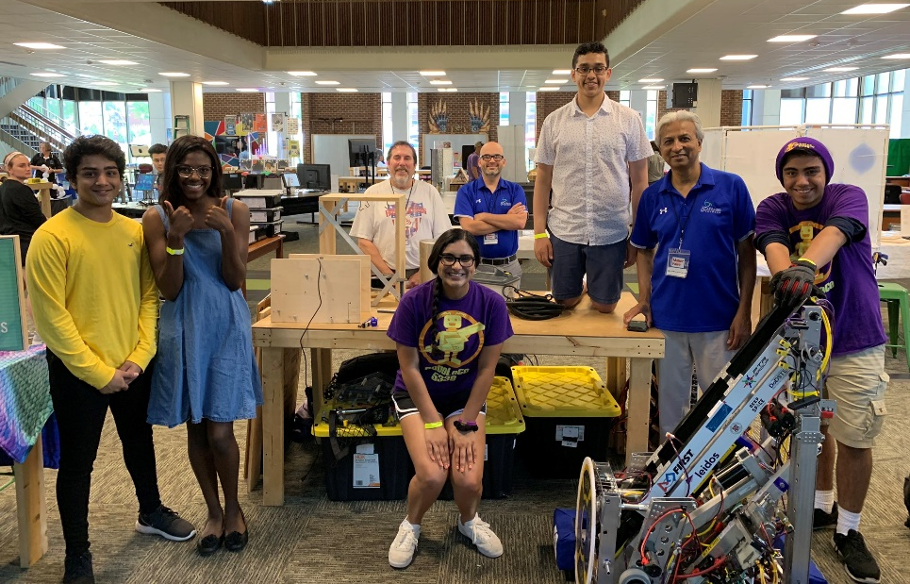
Notes:
The final step is helping students present their work at events like local Maker Faires in the lower left. Or by hosting events like the LCPS Student Maker Showcase that in the big picture, this is right outside my makerspace with over 200 students presenting their work. (which I helped organize.)

